Slide 1

Sebe Msomi
Moipone Kabai

Slide 2
Process analysis
We use process analysis to understand what is going on in our process. We will be looking for information about the process’s problem and inefficiencies.
We have identified key characteristics to remain successful and profitable during level 3 lockdown.
We used process analysis techniques to improve our tourism system.

Slide 3
Process Change
Improvement identification – we will use the results of the process analysis to identify ways to challenge quality problems such as travel restrictions, accommodation bookings are not allowed, and restaurants are closed,
Cost inefficiencies that we have identified during tourism system analysis.
We will propose new methods that allow our tourism system to display all accommodations and restaurants that are open for domestic traveling and operating during level 3. create methods that increase revenue.

Slide 4
Process Change
Process change introduction – we will implement the methods that we have proposed during the improvement identification stage and we will integrate these methods with other activities and ensure compatibility between these process activities.

Slide 5
Process Change
Process training – as the developers that have been involve during the building of the tourSpace system, it will not be a challenge to incorporate and understand these new proposed changes and how to implement them.
The training that we will be required would be when new tools are introduced.

Slide 6
Process Change
Change tuning – we will perform a test on our tourSpace system to discover minor problems. After discovering these problems, we will propose and introduce modifications to the process and if we are happy with the process, the changes will be completely operative.

Slide 7
Process Change
Improvement prioritization – we will assess all the possible changes on our tourSpace system and prioritize them for implementation. We will prioritize the changes based on criticality. We will start with the high, medium and low priority therefore to avoid introducing all the changes at once.
We will decide on the process areas that need improvement, how much to introduce these changes and their impact on our tourSpace system.

Slide 8
Implement Process Change
We will implement these changes by developing a communication strategy that include a timeline for how the change will be incrementally communicated and how will the change be communicated. Provide effective training to teach the skills and knowledge required to operate efficiently. We will introduce new practices, methods and tools as well as new roles or responsibilities. Measure the change process to ensure that we have achieved our goal

Slide 9
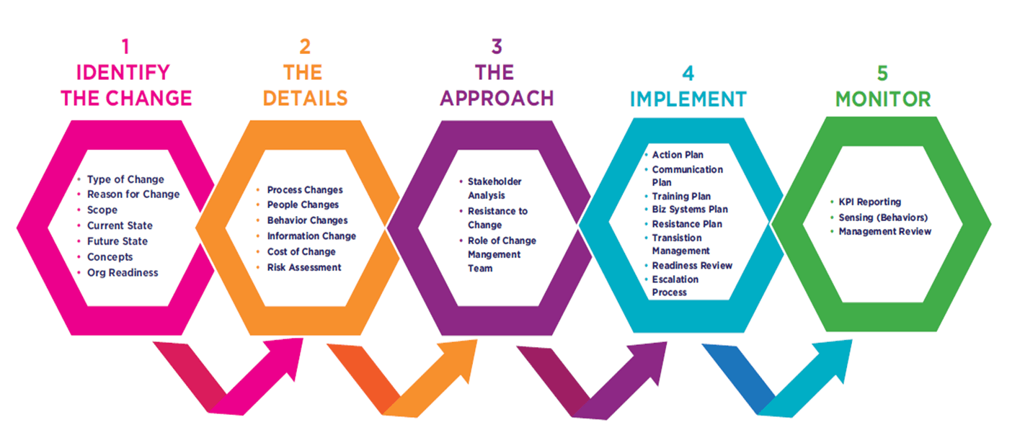
Process Change

Slide 10
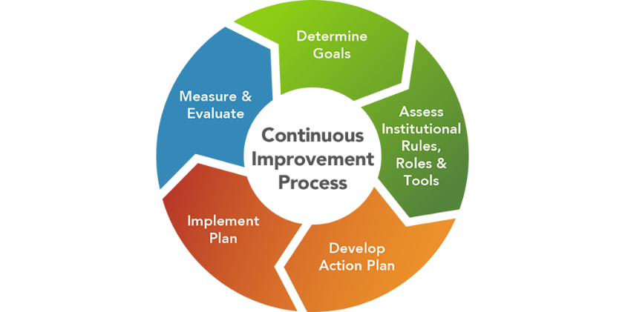
Process Change

Slide 17
Past the ½ way

Slide 20
DONE!

